Slide 1




Strongly Interacting Matter under Extreme Conditions
Volodymyr Vovchenko (University of Houston)
vvovchen@central.uh.edu – https://vovchenko.net
UL Lafayette Physics Seminar
Oct 22, 2025

Slide 2
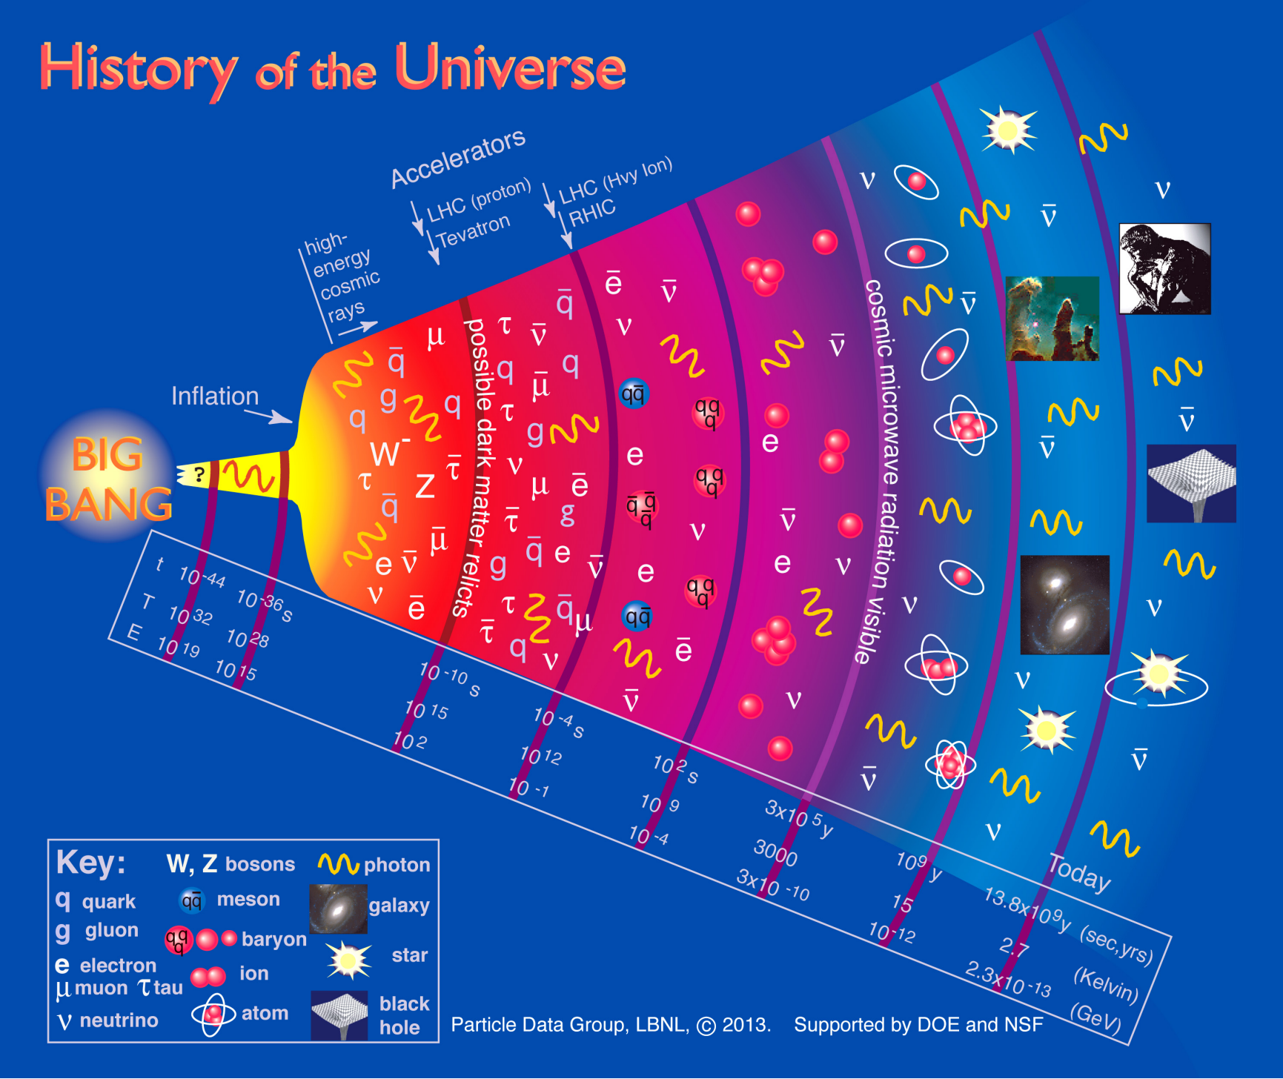
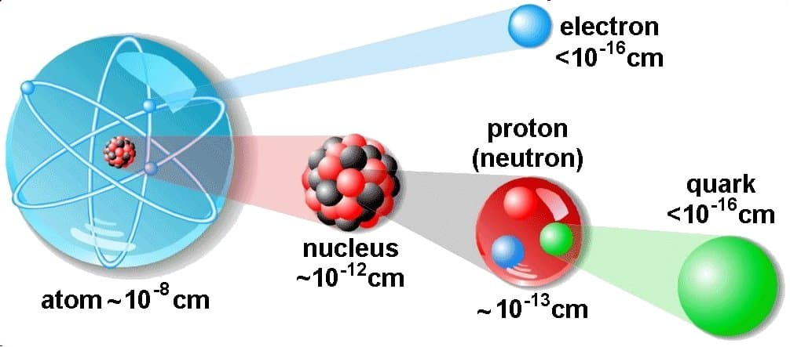

Structure of matter
2

Slide 3
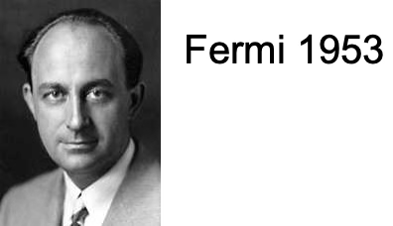
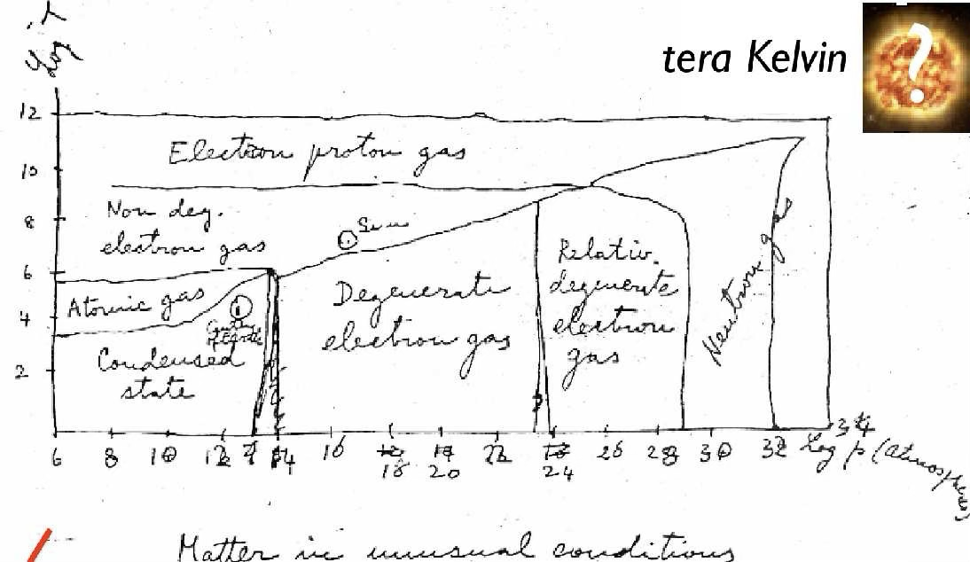
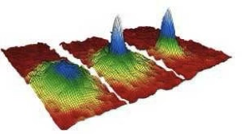
Extreme states of matter
log T
1 MeV ~ 10¹⁰ K
log p
3

Slide 4
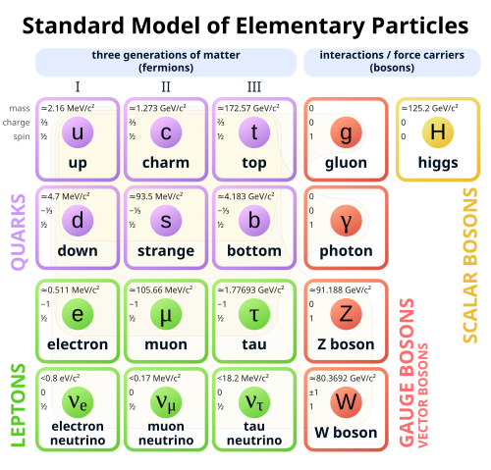
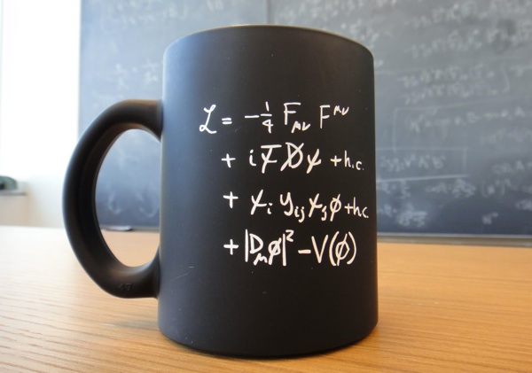
Standard model
Strong (nuclear) force
  Quarks and gluons, short-range
Electromagnetic force
  Charged particles (Coulomb), long-range
Weak force
  Fermions (incl. neutrinos)
mid-1970s
Predicted the top quark (disc. 1995), the tau neutrino (disc. 2000), and the Higgs boson (disc. 2012)
4

Slide 5
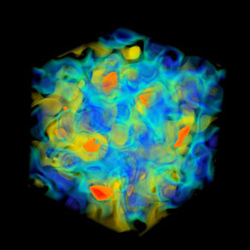

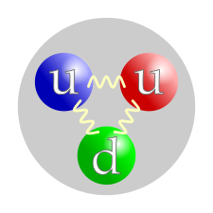

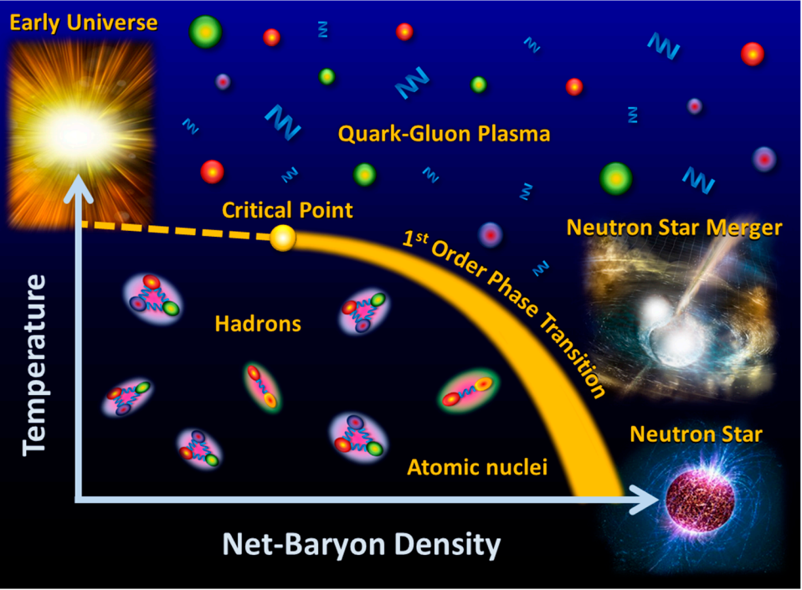
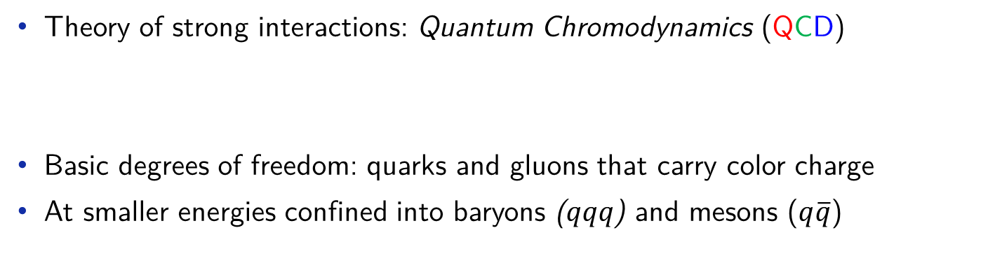
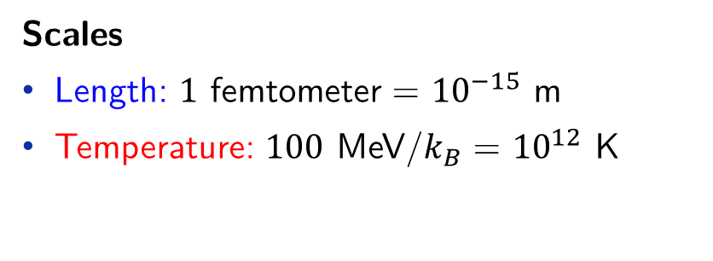
Strongly interacting matter
Theory of strong interactions: Quantum Chromodynamics (QCD)
Basic degrees of freedom: quarks and gluons that carry color charge
At smaller energies confined into baryons ($qqq$) and mesons ($q\overline{q}$)
Scales
Length: $1$ femtometer = ${10}^{−15}$ m
Temperature: $100$ MeV/$k_{B}$ = ${10}^{12}$ K
Where is it relevant?
Early Universe
Astrophysics: Neutron star (mergers)
Studied in laboratory with heavy-ion collisions
5

Slide 6

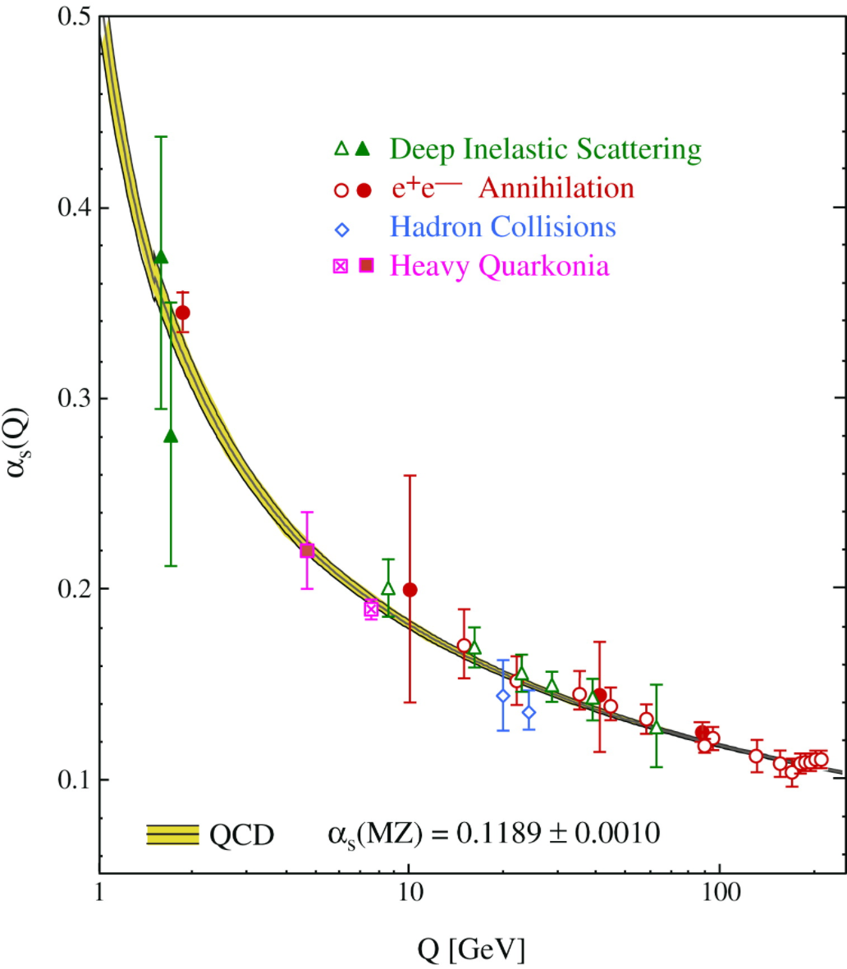
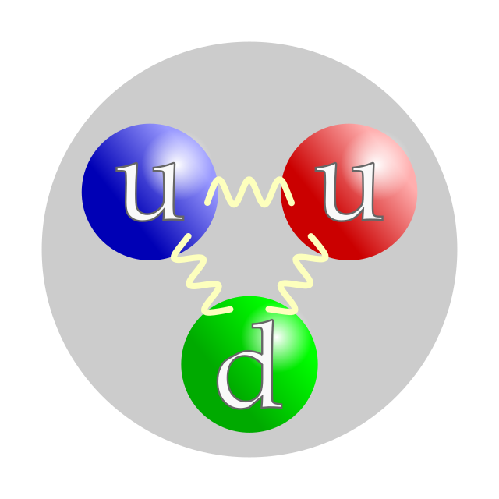
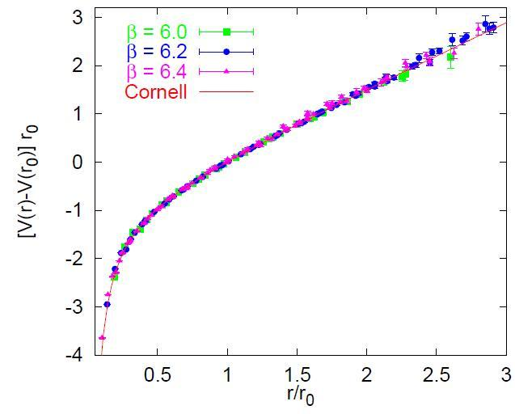
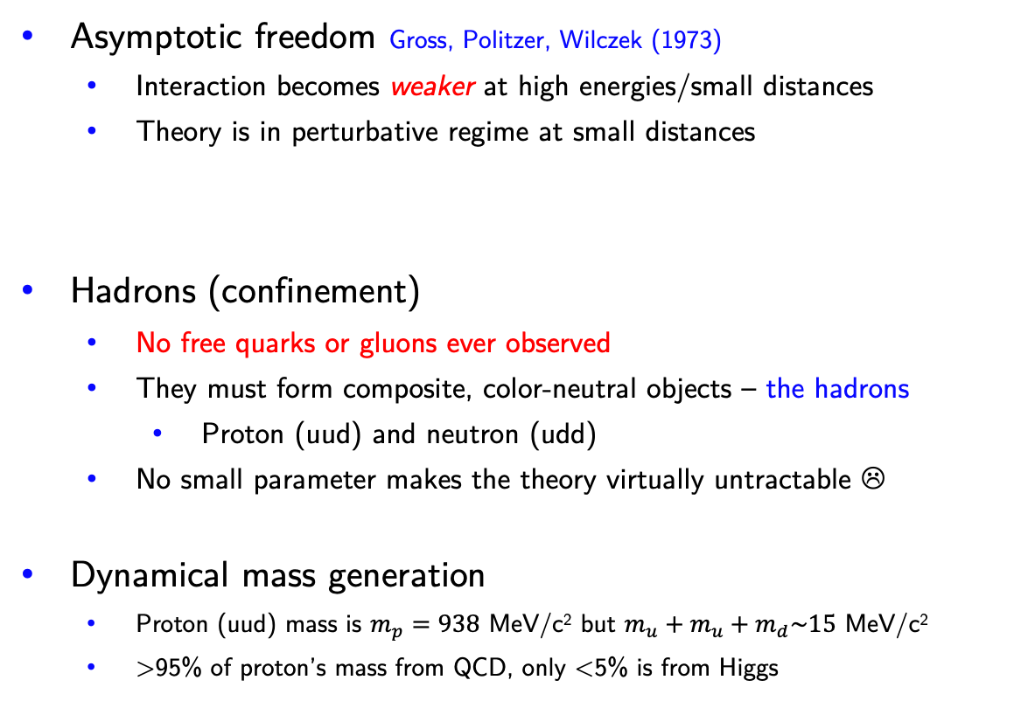
QCD features and emergent phenomena
Asymptotic freedom Gross, Politzer, Wilczek (1973)
  Interaction becomes weaker at high energies/small distances
  Theory is in perturbative regime at small distances
Hadrons (confinement)
  No free quarks or gluons ever observed
  They must form composite, color-neutral objects – the hadrons
    Proton (uud) and neutron (udd)
  No small parameter makes the theory virtually untractable ☹
Dynamical mass generation
  Proton (uud) mass is $m_{p}=938$ MeV/c² but $m_{u}+m_{u}+m_{d}\sim 15$ MeV/c²
  >95% of proton’s mass from QCD, only <5% is from Higgs
2004
S. Bethke
G. Bali
6

Slide 7
Confinement
Forces usually get weaker with distance
electron
can easily separate constituents
F ~ 1/r²
nucleus
neutral atom
7

Slide 8
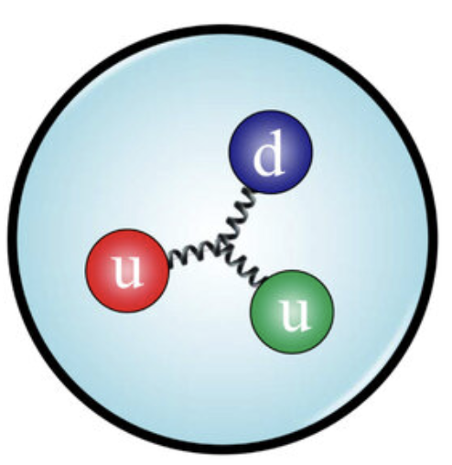

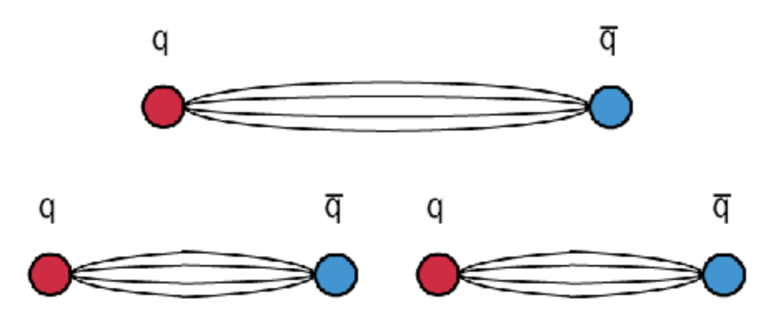

Confinement
Forces usually get weaker with distance
electron
-
can easily separate constituents
+
F ~ 1/r²
charged
nucleus
Quarks in QCD are confined
Try to separate quarks
F ~ r
“white” proton
(confined quarks)
“white” pion
(confined $q\overline{q}$)
quark-antiquark pair
created from vacuum
7

Slide 9
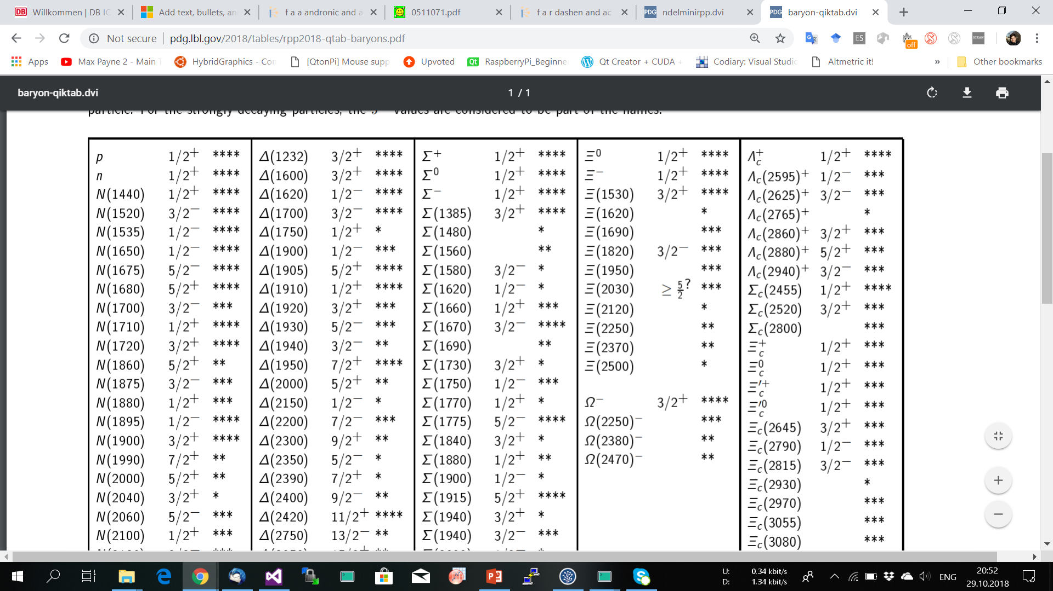

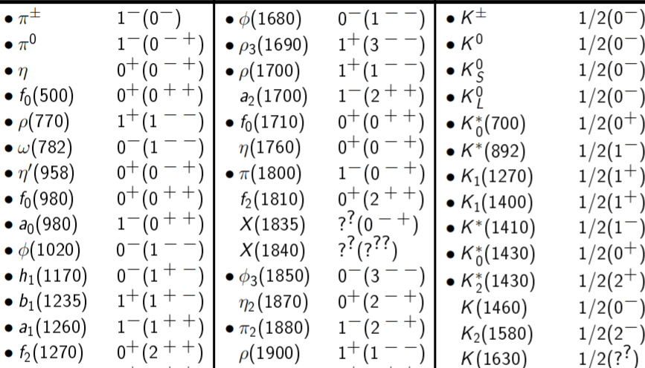
Confinement and hadron spectrum
From a few elementary degrees of freedom in QCD, hundreds of composite hadrons emerge
emergent property of QCD
>400 species
8

Slide 10
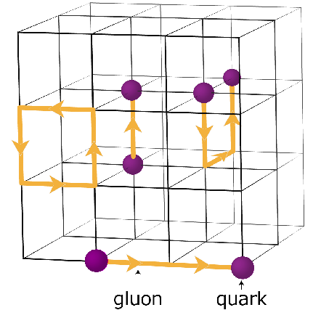

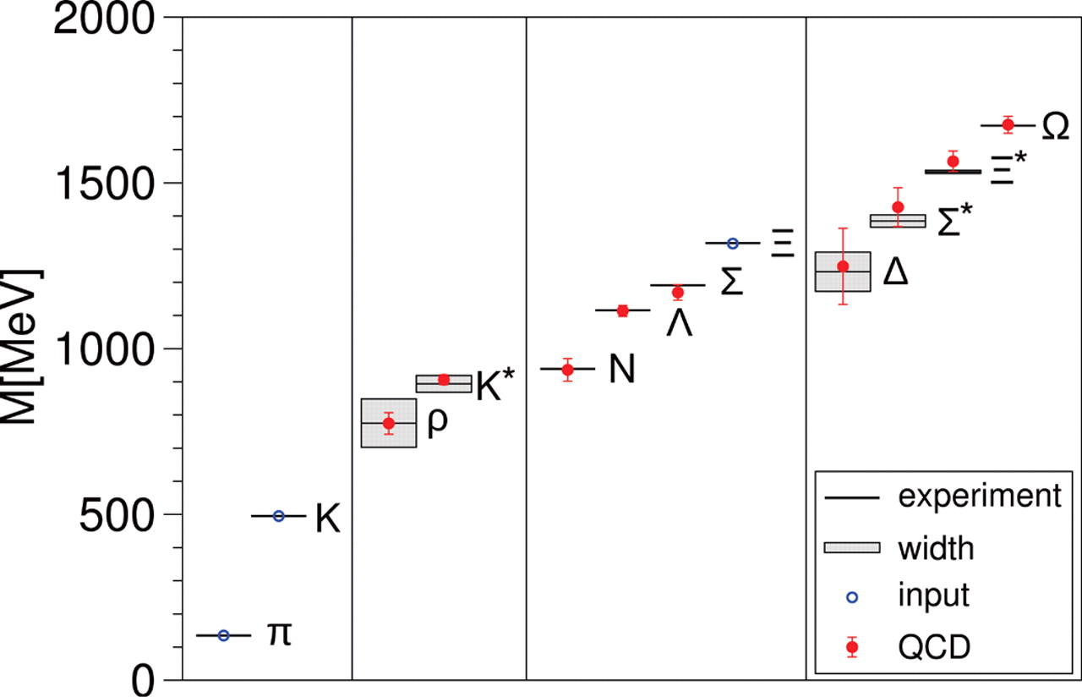
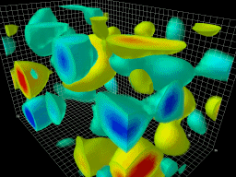
Non-perturbative methods
First-principle tool: Lattice QCD – a brute force Monte Carlo solution on a discretized space-time grid
Ab-initio calculation of hadron masses
BMW Collaboration, Science 322, 1224 (2008)
© CSSM, University of Adelaide
  Remarkable agreement of QCD with the experiment
9

Slide 11

From confinement to deconfinement
heating
compression
→ deconfined color matter (quark-gluon plasma)
Nuclear Matter
(confined)
Quark Gluon Plasma
deconfined !
Hadronic Matter
(confined)
Adapted from R. Bellwied (QuarkNet-2023)
10

Slide 12
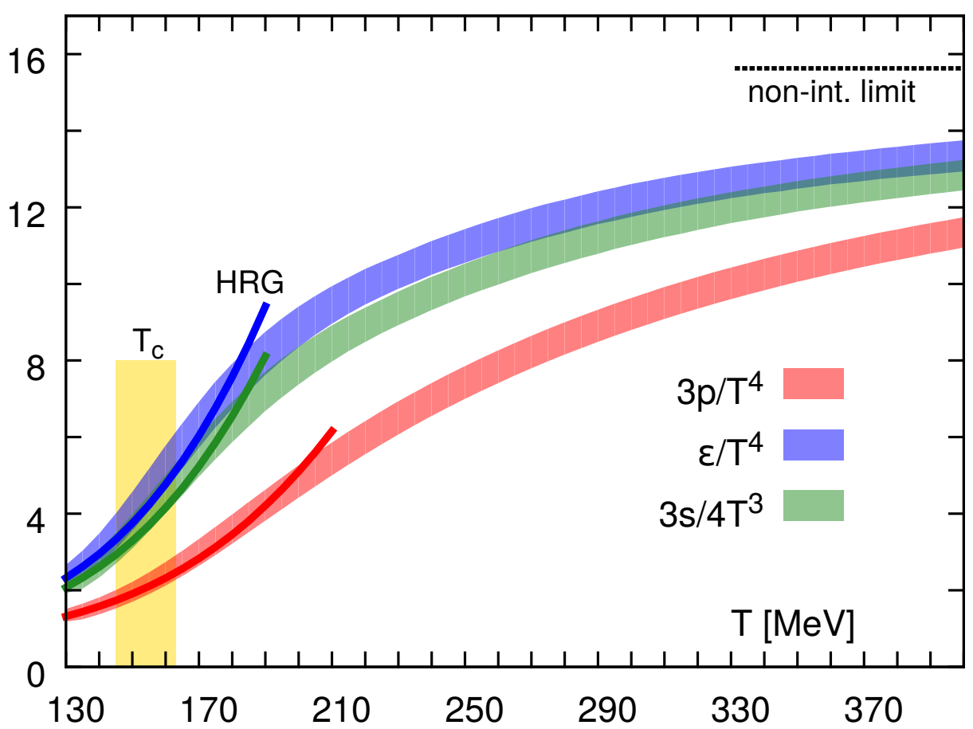
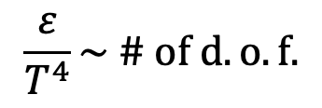
Deconfinement transition from lattice QCD
$$\frac{ε}{T^{4}}\sim \# of d.o.f.$$
deconfined:
many d.o.f
confined:
few d.o.f.
Figure from HotQCD coll., PRD ‘14
Crossover transition at T_{C} ≈ 155 MeV ≈ 2⋅10¹² K ≈ 130,000⋅T [Sun’s core]
[Y. Aoki et al., Nature 443, 675 (2006)]
11

Slide 13
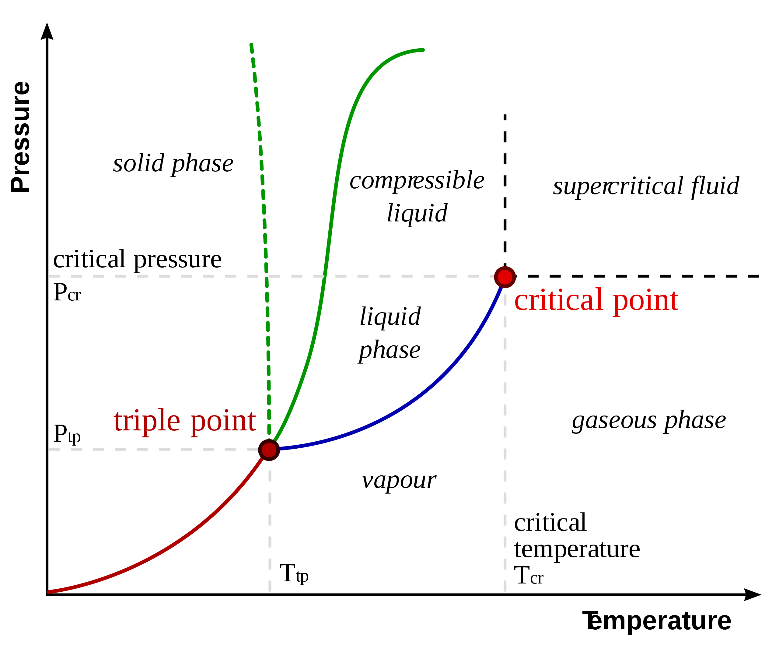
QCD phase diagram
lattice QCD
Excess of particles over antiparticles
Finite baryon densities inaccessible due to the sign problem
Possible existence of a phase transition is a conjecture
Laboratory: heavy-ion collisions – test of QCD and a tool unveil its many properties
12

Slide 14
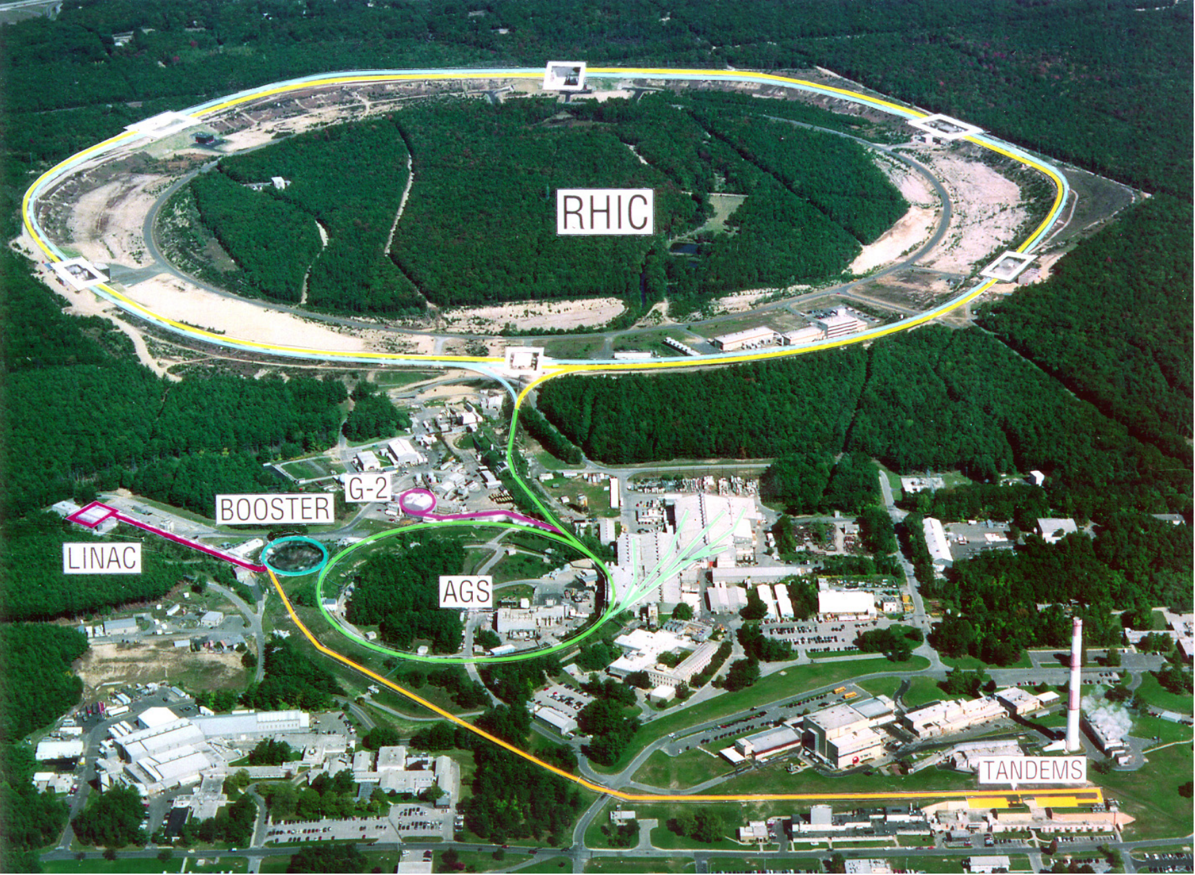
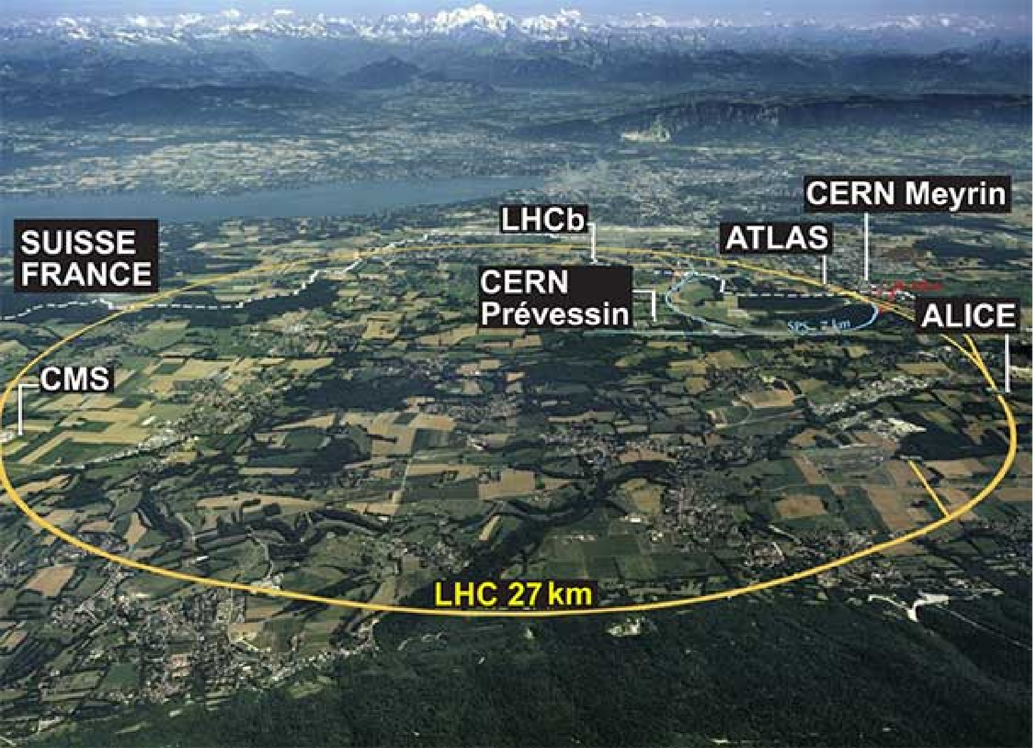

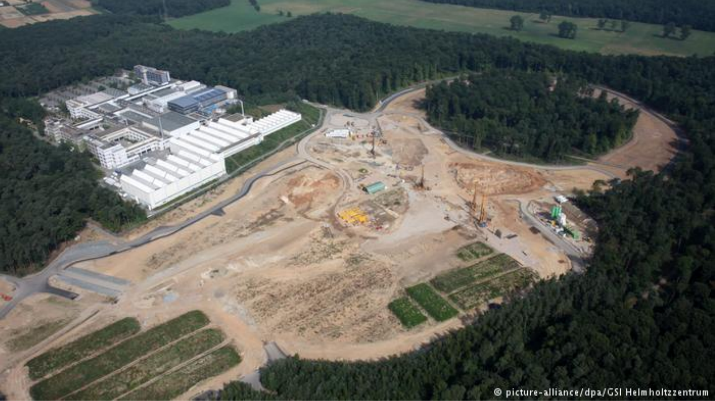
QCD laboratories (~1980-…)
RHIC@BNL (2000-), 200 GeV, 99.995% speed of light
LHC@CERN (2010-), 5020 GeV, 99.9999991% speed of light
ALICE detector
@LHC
FAIR@GSI [2026(?)-], 5 GeV (less is more)
13

Slide 15
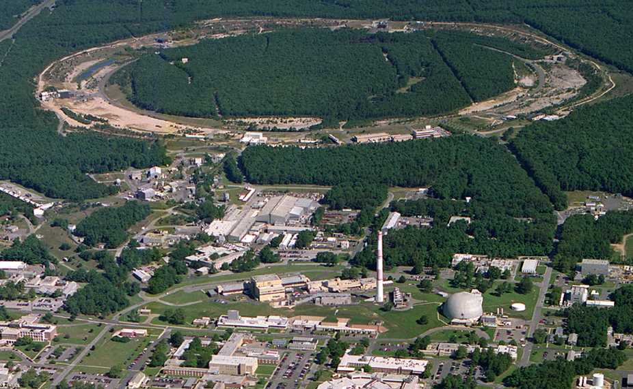
Relativistic Heavy Ion Collider (RHIC)
PHOBOS
1 mile
RHIC
BRAHMS
PHENIX
Au+Au @ √s_{NN}=200 GeV
STAR
v = 0.99995⋅c
AGS
TANDEMS
Adapted from R. Bellwied (QuarkNet-2023)
14

Slide 16
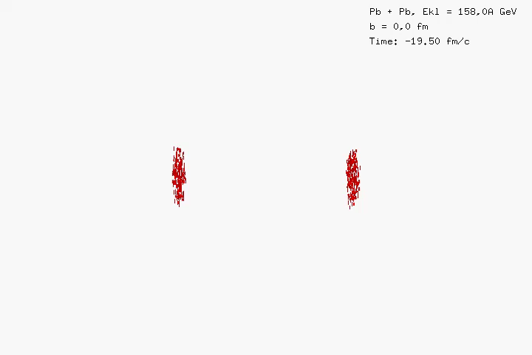
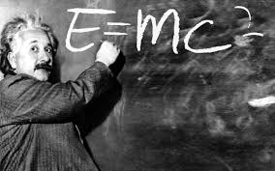
Relativistic heavy-ion collisions
Relativistic collision energy
leads to particle production
UrQMD model simulation
Length: 10⁻¹⁵ m
Time: 10⁻²² s
Temperature: 10¹² K
(femtometers)
(yoctoseconds)
(mega-electron volts)
15

Slide 17
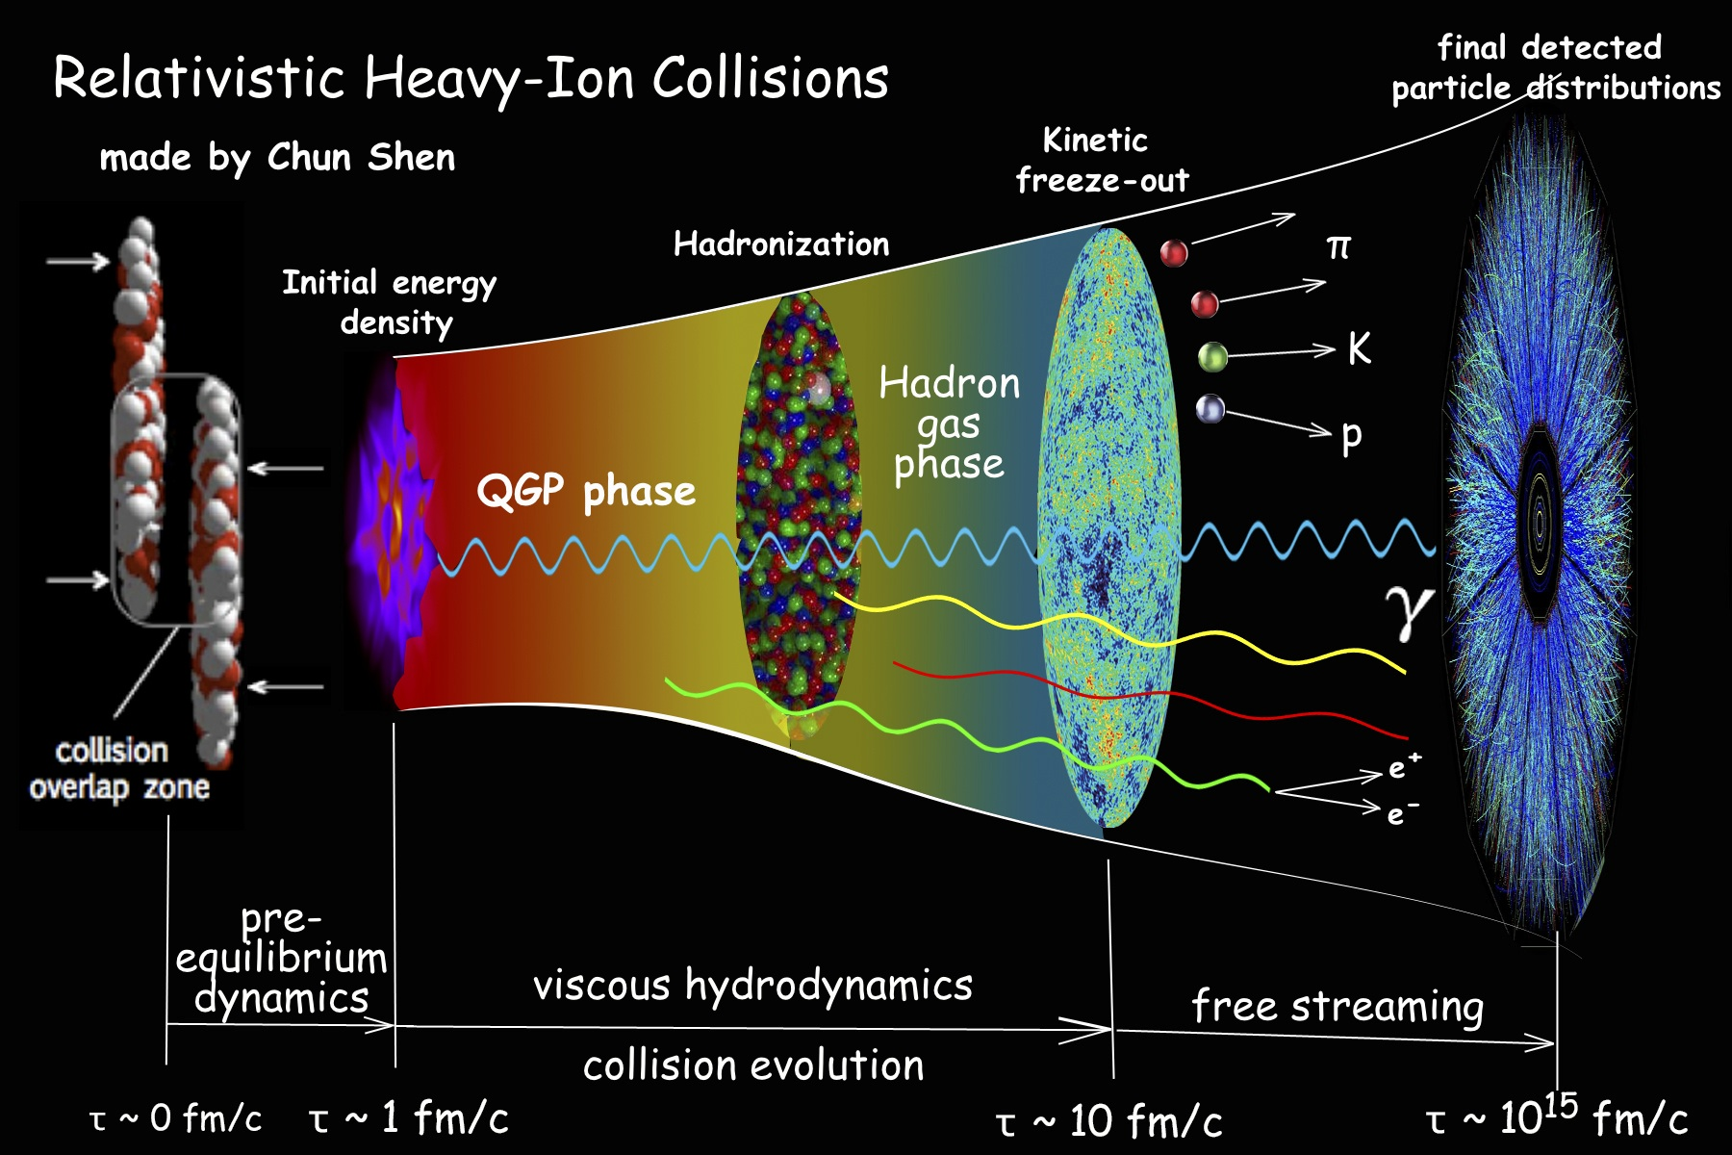
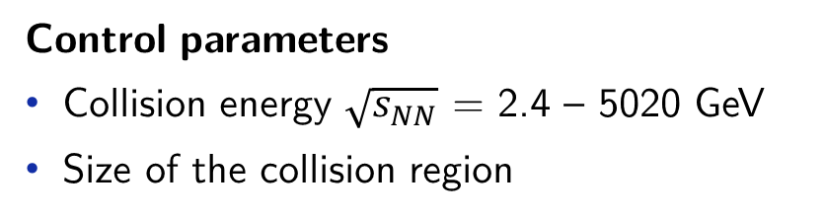
Relativistic heavy-ion collisions – “Little Bangs”
Control parameters
Collision energy $\sqrt{s_{NN}}$ = 2.4 – 5020 GeV
Size of the collision region
Measurements
Final hadron abundances and momentum distributions
16

Slide 18
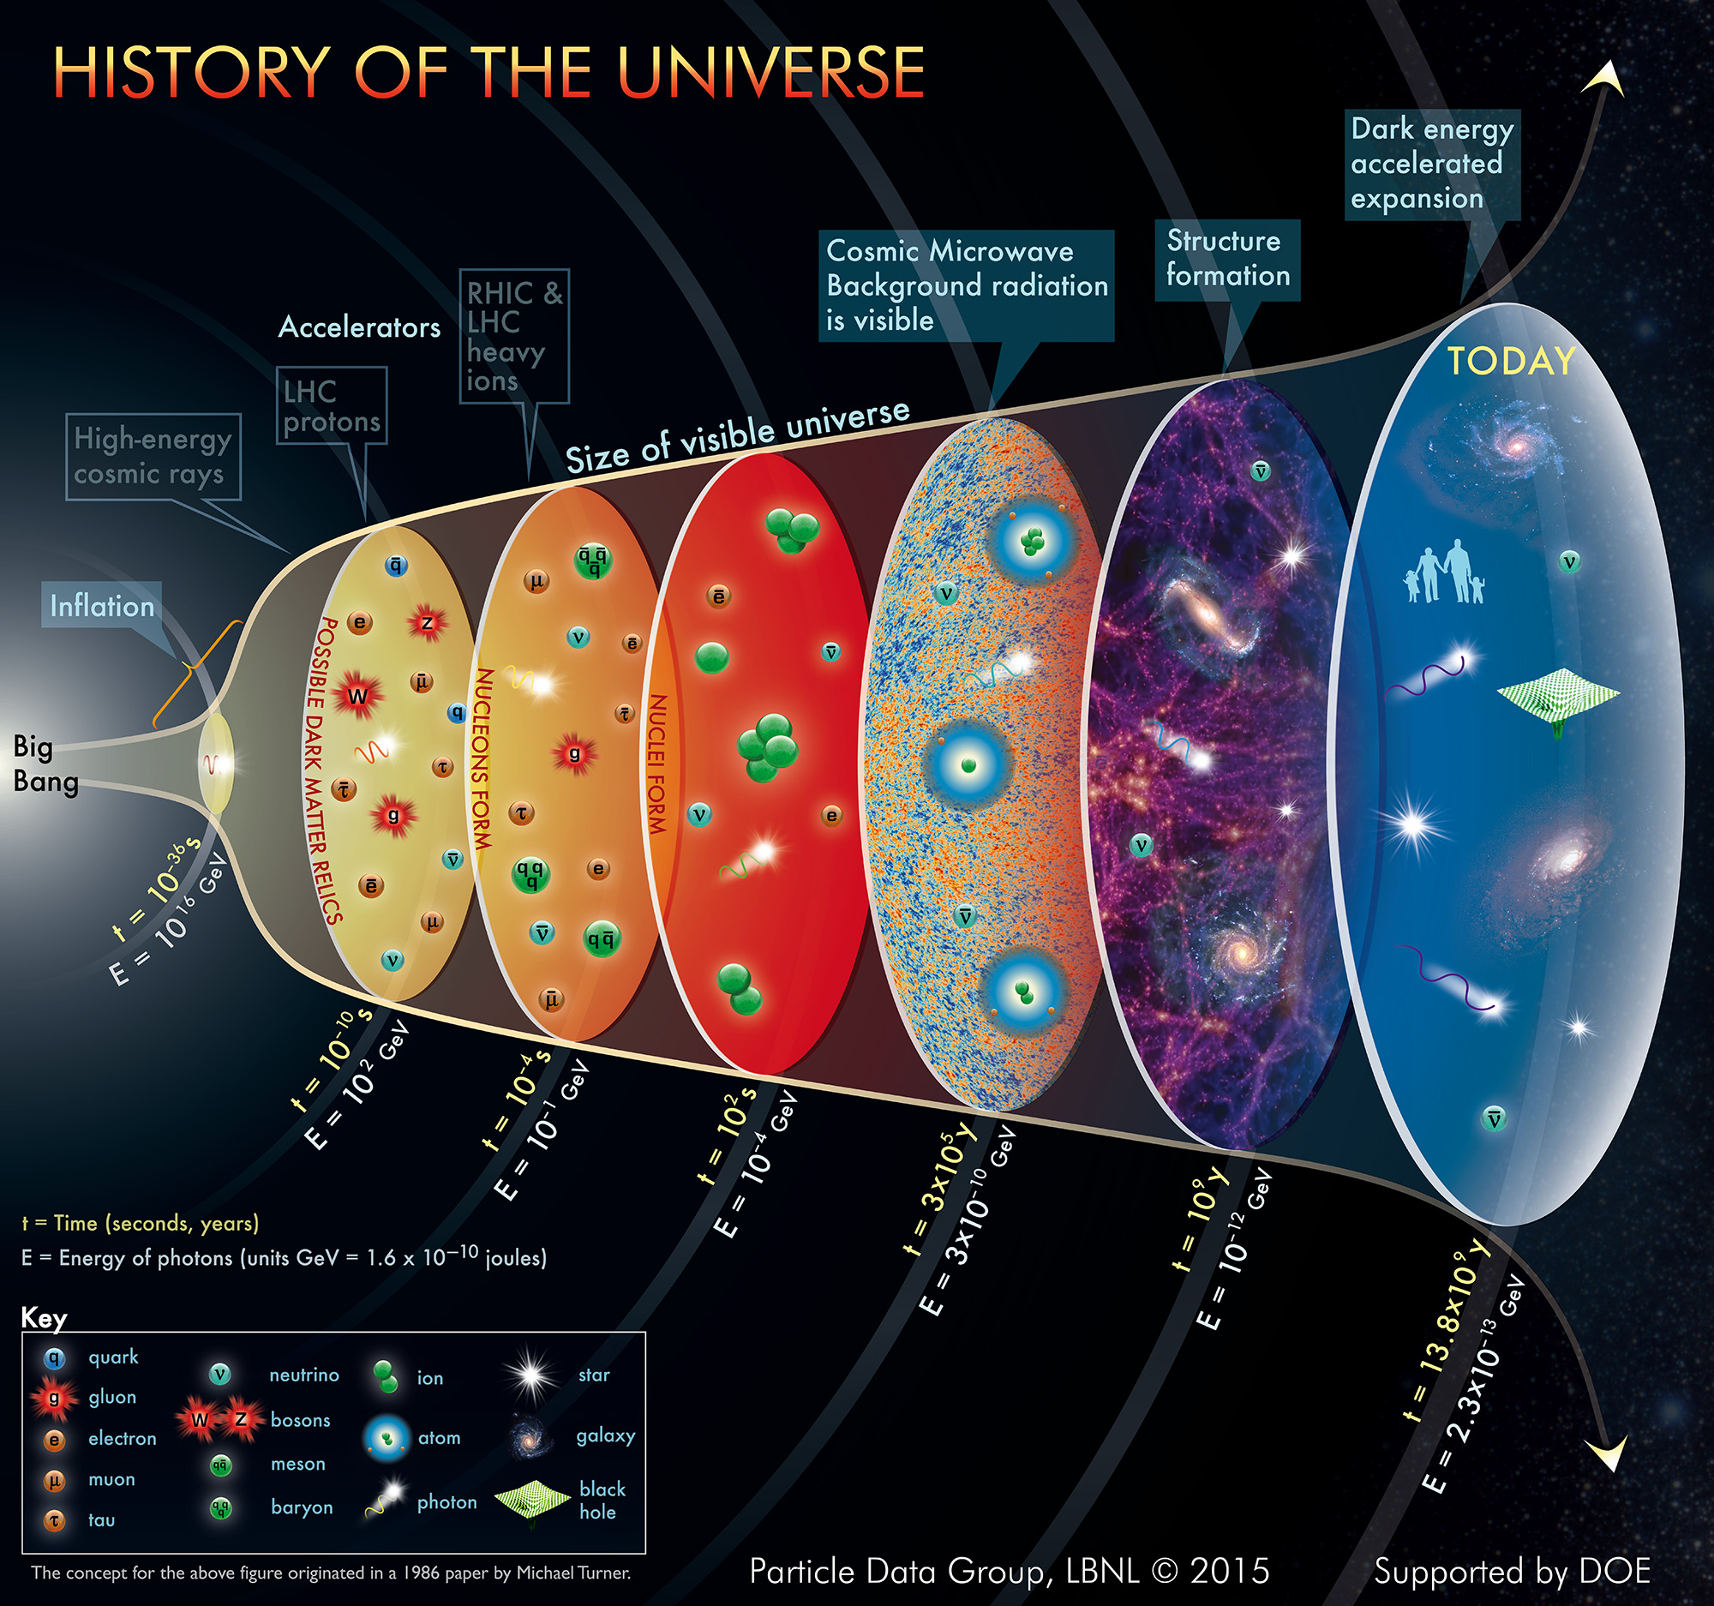
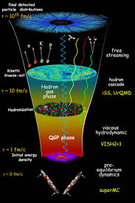
Big Bang vs Little Bang
Time
Big Bang
Heavy-Ion Collision
1 event
Millions of events
Slow expansion, long-lived
Rapid expansion, short-lived
17

Slide 19
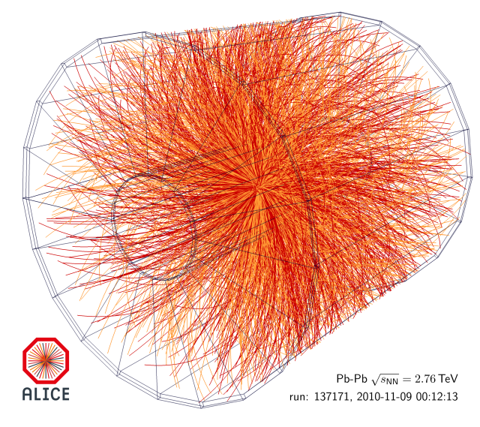
Fireball in heavy-ion collisions
Event display of a Pb-Pb collision in ALICE at the LHC
Thousands of particles created in relativistic heavy-ion collisions
Apply concepts of statistical mechanics
18
Notes:
The topic is related to probing the QCD phase diagram with heavy-ion collisions, one of the main motivations of these experimental programs. Heavy-ion collisions provide access to finite baryon density regions of the QCD phase diagram that are otherwise inaccessible, for instance lattice QCD cannot access it directly from first principles. Central collisions of heavy ions create thousands and even tens of thousands of particles, thus, it is sort of natural to apply concepts of statistical mechanics to describe heavy-ion collisions.

Slide 20
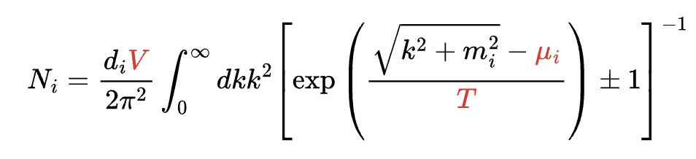
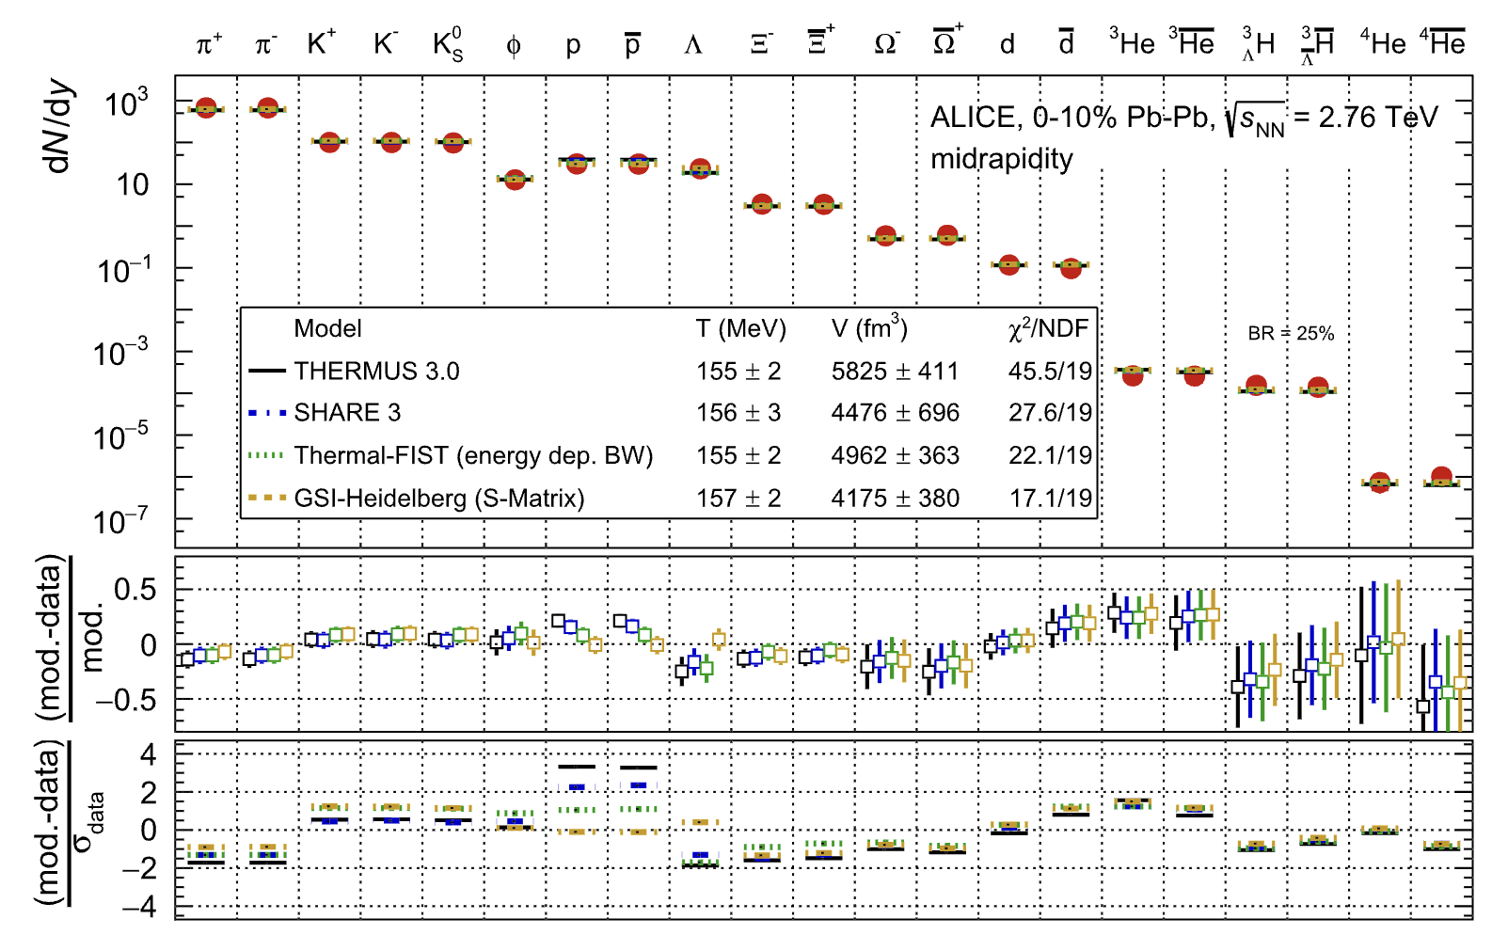
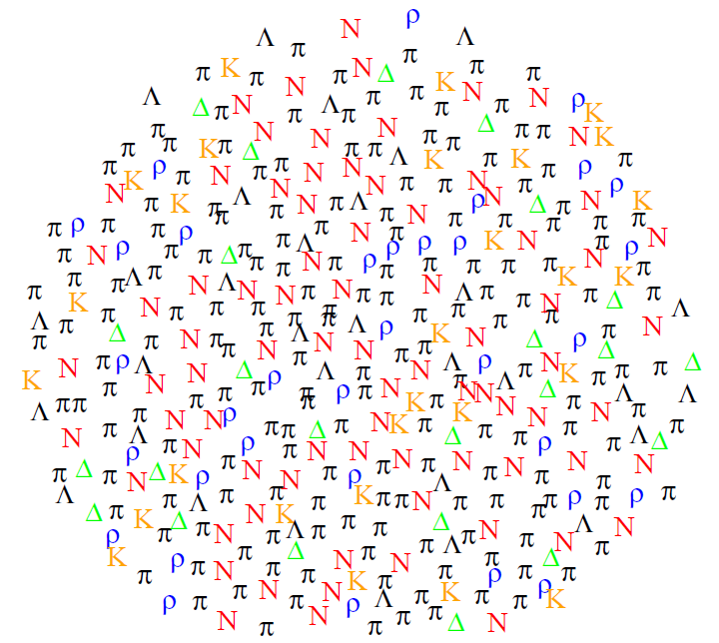

Particle production in heavy-ion collisions
Ideal gas law (E. Clapeyron, 1834)
$$P_{i}V=N_{i}k_{B}T$$
(+ feeddown)
is the simplest model of particle production
Bose-Einstein & Fermi-Dirac, 1924-1926
© J. Cleymans
ALICE Collaboration, EPJC 84, 813 (2024)
19
Notes:
The topic is related to probing the QCD phase diagram with heavy-ion collisions, one of the main motivations of these experimental programs. Heavy-ion collisions provide access to finite baryon density regions of the QCD phase diagram that are otherwise inaccessible, for instance lattice QCD cannot access it directly from first principles. Central collisions of heavy ions create thousands and even tens of thousands of particles, thus, it is sort of natural to apply concepts of statistical mechanics to describe heavy-ion collisions.

Slide 21
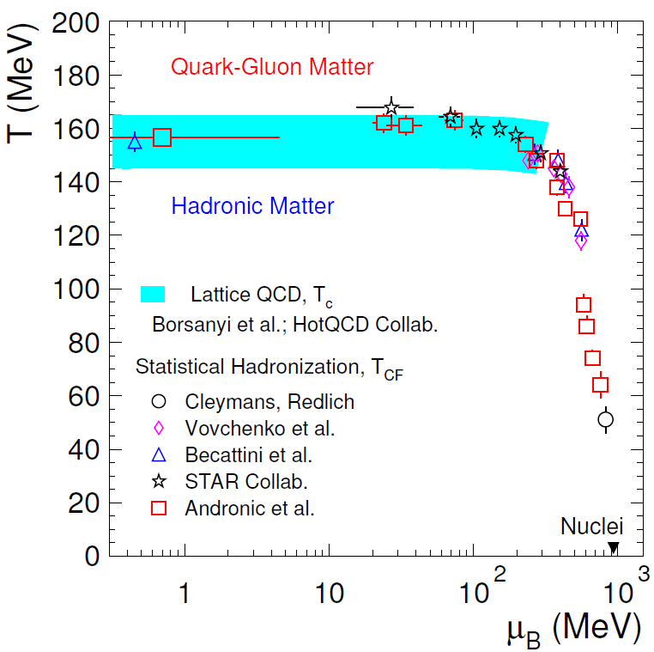
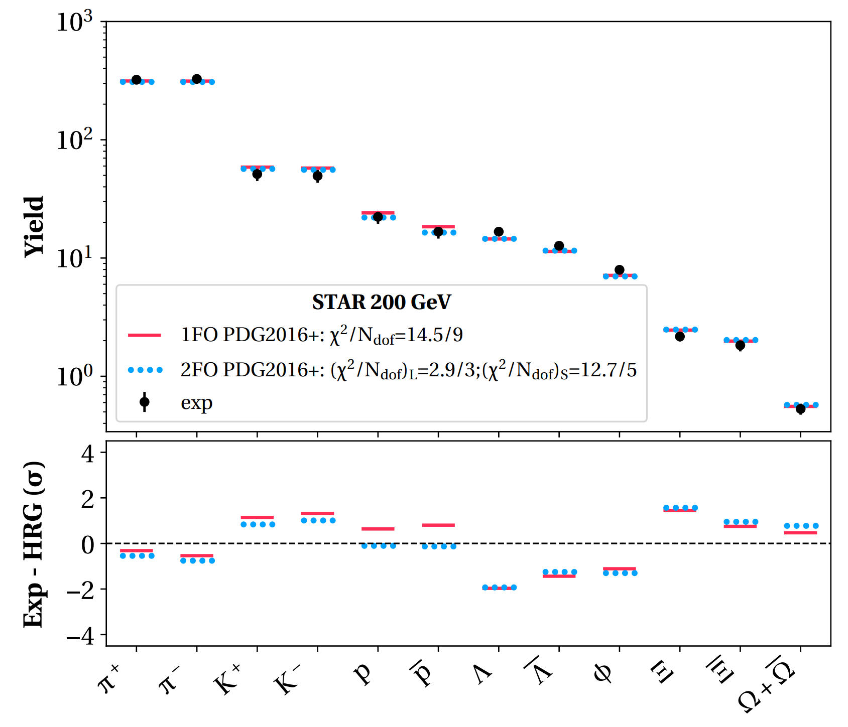
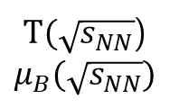

Mapping heavy-ion collisions onto the QCD phase diagram
Fit hadron yields with the HRG model
$T(\sqrt{s_{NN}}$)
$μ_{B}(\sqrt{s_{NN}})$
P. Alba et al. (UH group), Phys. Rev. C 101, 054905 (2020)
A. Andronic et al., Nature 561, 321 (2018)
$\sqrt{s_{NN}}↘$ $μ_{B}↗$
Heavy-ion freeze-out probes the QCD transition at zero and non-zero baryon density
20

Slide 22
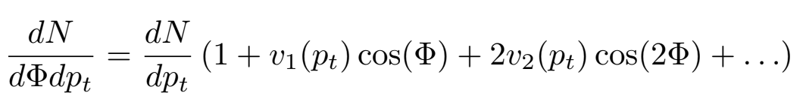
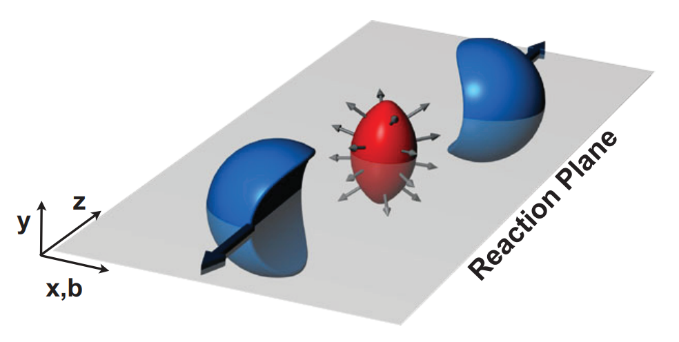
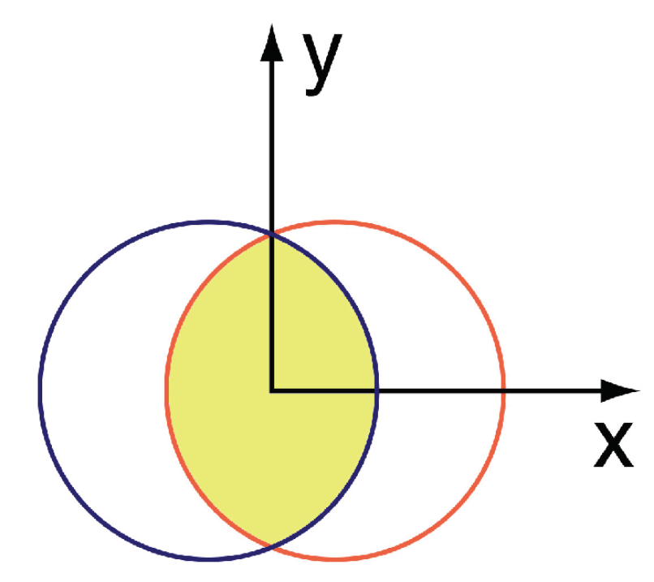
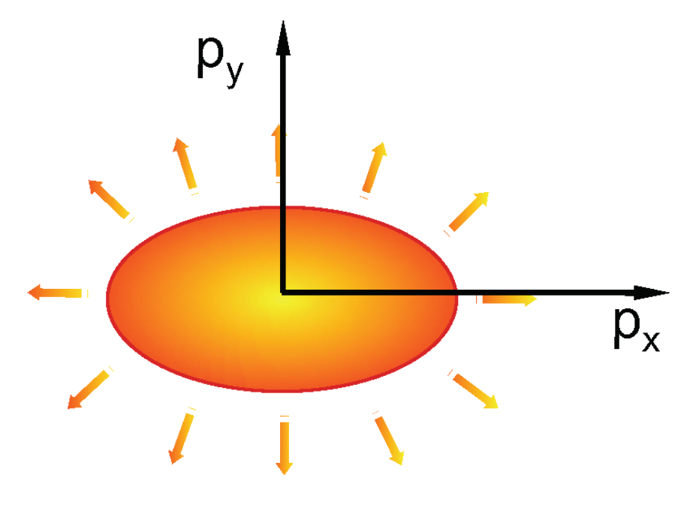

Flow and hydrodynamics
coordinate-space anisotropy
momentum-space anisotropy
(relativistic) hydrodynamics
21

Slide 23
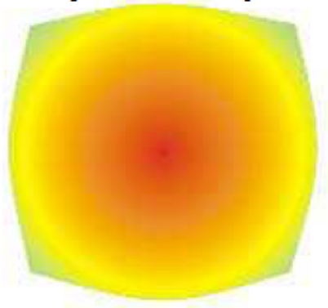
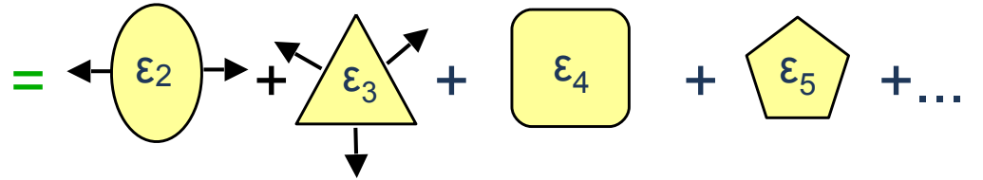
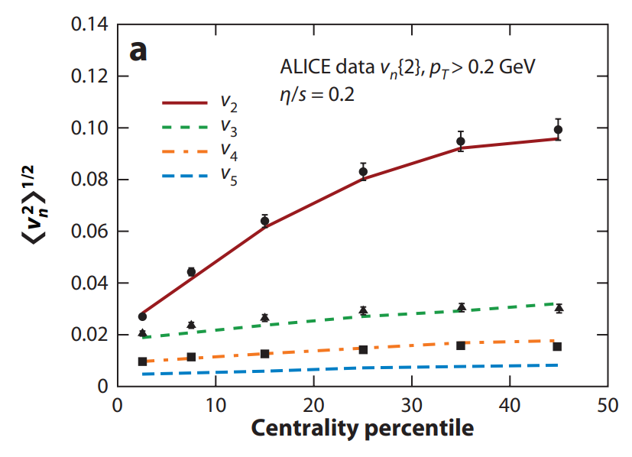


QGP is a fluid!
From ALICE Collaboration, Phys. Rev. Lett. 107, 032301 (2011)
From Bernhard, Moreland, Bass, Nature Physics 15, 1113 (2019)
Shear viscosity over entropy of QGP: $η/s≤0.25$ – a near ‘perfect’ fluid
The early universe behaves like a perfect liquid rather than a gas or plasma
22

Slide 24



QGP is the hottest and most vortical fluid created on Earth
23

Slide 25
The challenge of discovering the QCD critical point
Disclaimer: This is my area of active research

Slide 26

QCD critical point
Ordinary fluid (e.g. water)
QCD
?
Figure from Bzdak et al., Phys. Rept. ’20 and 2015 Nuclear Long Range Plan
What is the nature of the quark-hadron transition at finite baryon density?
Is there a QCD phase transition and critical point? Where?
Lattice QCD: sign problem prevents simulations at non-zero baryon density
Heavy-ion collisions: access to finite density but might be too short-lived to observe a signal
24

Slide 27






Extrapolating critical point from lattice QCD
van der Waals (1873)
change the variables
Critical Point:
Extrapolate from $μ_{B}=0!$
25

Slide 28



Looking for entropy crossings
Critical point ruled out (2$σ$ level) at $μ_{B}< 400$ MeV
Borsanyi et al., arXiv:2502.10267
Try going further
Expansion around $μ_{B}=0$
Shah, Hippert, Noronha, Ratti, VV, arXiv:2410.16026
First-order phase transition emerges at $μ_{B}>600$ MeV
26

Slide 29



QCD critical point estimates
Critical point estimate at ${O(μ}_{B}^{2})$:
$T_{c}=114±7$ MeV, $μ_{B}=602±62$ MeV
Estimates from recent literature:
YLE-1: D.A. Clarke et al. (Bielefeld-Parma), arXiv:2405.10196
YLE-2: G. Basar, PRC 110, 015203 (2024)
BHE: M. Hippert et al., arXiv:2309.00579
fRG: W-J. Fu et al., PRD 101, 054032 (2020)
DSE/fRG: Gao, Pawlowski., PLB 820, 136584 (2021)
DSE: P.J. Gunkel et al., PRD 104, 052022 (2021)
FSS: A. Sorensen et al., arXiv:2405.10278
Optimist’s view: Different estimates converge onto the same region because QCD CP is likely there
Pessimist’s view: Different estimates converge onto the same region because it’s the closest not yet ruled out by LQCD
Can be tested in laboratory with heavy-ion collisions
27

Slide 30

Critical point and fluctuations
Density fluctuations at macroscopic length scales
Critical opalescence
Unfortunately, we cannot do this in heavy-ion collisions
28

Slide 31








Event-by-event fluctuations and statistical mechanics
Consider a fluctuating number N
Cumulants:
Experiment:
variance width
skewness asymmetry
kurtosis peak shape
Statistical mechanics:
Grand partition function
Cumulants measure chemical potential derivatives of the (QCD) equation of state
29

Slide 32






Example: (Nuclear) Liquid-gas transition
(QCD) critical point: large correlation length and fluctuations
M. Stephanov, PRL ’09, ‘11
Critical opalescence
$$\left\langle N^{2}\right\rangle −{\left\langle N\right\rangle }^{2} \sim \left\langle N\right\rangle \sim {10}^{23}$$
in equilibrium
VV, Anchishkin, Gorenstein, Poberezhnyuk, PRC 92, 054901 (2015)
30

Slide 33




Example: Critical fluctuations in microscopic simulation
V. Kuznietsov (grad student @UH) et al., Phys. Rev. C 105, 044903 (2022)
Instead of observing system macroscopically, track each single particle
Classical molecular dynamics simulations of the Lennard-Jones fluid near critical point ($T≈1.06T_{c}$, $n≈n_{c}$) of the liquid-gas transition
thermod. limit
z
Large fluctuations survive despite strong finite-size effects and are large as advertised near the critical point
31

Slide 34

Equilibrium Expectations and Beam Energy Scan
Compare recent CP estimates and the freeze-out curve
N. Xu, CPOD 2016
One of primary motivations for beam energy scan (BES) programs at RHIC
BES-I (7.7-200 GeV) and BES-II (3-4.5 & 7.7-39 GeV)
32

Slide 35




Measuring cumulants in heavy-ion collisions
Count the number of events with given number of e.g. (net) protons
STAR Collaboration, Phys. Rev. Lett. 126, 092301 (2021)
Statistics-hungry observables
Cumulants are extensive, $κ_{n}\sim V$, use ratios to cancel out the volume
Look for subtle critical point signals
33

Slide 36





History of proton cumulants at RHIC
BES-Ia
guidance from theory
guidance from theory (higher moments)
BES-Ib
BES-II
https://vovchenko.net/inspire-citation-history/?recids=471221-797125-1255072-1850675-2906592
33

Slide 37





Statistical ensemble in HICs is neither CE or GCE
Experimental measurements apply momentum cuts
  The idea is to mimick GCE conditions
However, in reality, the measured subsystem is of comparable size to total system where baryon number does not fluctuate and the canonical ensemble (CE) applies
$$\frac{κ_{2}}{κ_{1}}=\frac{χ_{2}}{χ_{1}}$$
$$\frac{κ_{2}}{κ_{1}}=(1−α)\frac{χ_{2}}{χ_{1}}$$
VS
Statistical ensemble relevant for heavy-ion collisions is something “in-between” GCE and CE
34

Slide 38





Theory vs experiment
guidance from theory
experiment (the real thing)
Comparing theory and experiment should be done very carefully
Some effects that are unrelated to the CP may masquerade the signal
On the other hand, due to rapid expansion of the fireball the actual critical point signal may be very subtle
hydro simulation
track reconstruction
event selection
critical slowing down
kinematic cuts
efficiency correction
canonical effects
CBWC
purity
hadronic phase
35

Slide 39

Hints from RHIC-BES-I
Quantitative calculations of critical fluctuations are still not available
State-of-the-art non-critical baseline computed using hydrodynamics
VV, V. Koch, C. Shen, Phys. Rev. C 105, 014904 (2022)
Subtract it from the data and look for a possible signal of CP
Analysis of RHIC-BES-II data in progress
36
Notes:
Let me talk about the results of my research instead. Here are the cumulant ratios for the net proton number. The normalized skewness, kurtosis and hyperkurtsos.
The skewness is normalized by the first cumulant rather than by the second one as often done, this quantity then has a well established baseline of unity corresponding to uncorrelated particle production.
The lines are model calculations, the solid lines are full calculations, with baryon conservation and excluded volume. The dotted lines are without baryon conservation, excluded volume only. The dash-dotted lines are without the excluded volume but with baryon conservation. These calculations compare well with recent analysis of baryon number conservation effects in canonical ideal HRG model shown by the blue symbols. The agreement indicates consistency of the results with prior literature.
The STAR data for the third cumulant are fairly accurate. We see that a quantitative description is obtained above 20 GeV energy when we simultaneously incorporate baryon conservation and excluded volume. Among the two effects it is seen that baryon conservation is stronger.
At low energies the data are underestimates, this will be covered more on the next slides. The kurtosis seems to agree well with the data, but error bars are large. Will be interesting to see the upcoming more accurate data. Finaly, for the hyperkurtosis it predicts to become negative say below 50 GeV.

Slide 40









First data from RHIC-BES-II
37
Notes:
Let me talk about the results of my research instead. Here are the cumulant ratios for the net proton number. The normalized skewness, kurtosis and hyperkurtsos.
The skewness is normalized by the first cumulant rather than by the second one as often done, this quantity then has a well established baseline of unity corresponding to uncorrelated particle production.
The lines are model calculations, the solid lines are full calculations, with baryon conservation and excluded volume. The dotted lines are without baryon conservation, excluded volume only. The dash-dotted lines are without the excluded volume but with baryon conservation. These calculations compare well with recent analysis of baryon number conservation effects in canonical ideal HRG model shown by the blue symbols. The agreement indicates consistency of the results with prior literature.
The STAR data for the third cumulant are fairly accurate. We see that a quantitative description is obtained above 20 GeV energy when we simultaneously incorporate baryon conservation and excluded volume. Among the two effects it is seen that baryon conservation is stronger.
At low energies the data are underestimates, this will be covered more on the next slides. The kurtosis seems to agree well with the data, but error bars are large. Will be interesting to see the upcoming more accurate data. Finaly, for the hyperkurtosis it predicts to become negative say below 50 GeV.

Slide 41




QCD in astrophysics
Neutron stars are extremely compact objects (1-2 solar masses confined to an 8-mile sphere)
Pressure of dense nuclear matter balances the gravitational pull
38

Slide 42


QCD in astrophysics
Properties of dense nuclear matter define how heavy neutron stars can be and how large they are
Observational constraints
Intermediate-energy
heavy-ion collisions
Intermediate energy heavy-ion collisions probe same dense nuclear matter
39

Slide 43



The ultimate “heavy-ion” collision
Most et al., PRD (2023)
40

